Slide 1


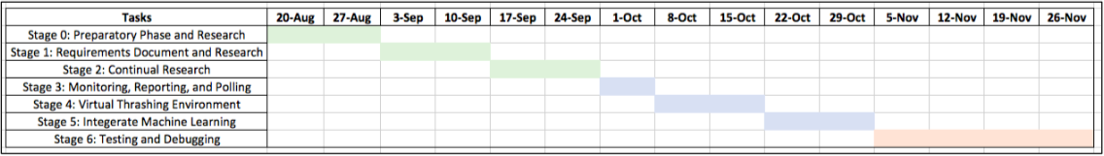
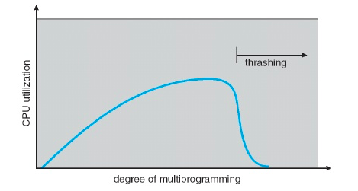
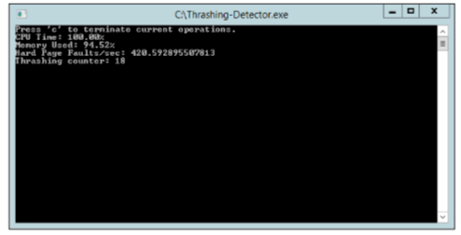
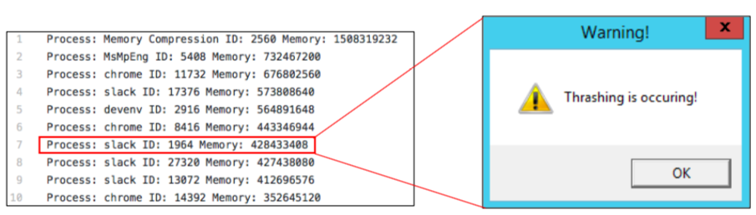
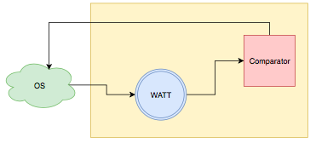
Windows Application Thrashing Tool (WATT)
Joseph Caton, My Nguyen, Brooks Olney, Thomas Pannozzo
Department of Computer Science and Engineering
SunView Software Background
Project Plan
Design and Analysis
SunView Software, located in Tampa FL, is a leading provider of IT Service Management, Change Management, and Service Desk ticketing solutions.
WATT was created in a span of 16 weeks through lots of research, communication, testing, debugging, and teamwork.
Currently, a commercial product is not available to detect thrashing.
WATT is designed to output two (2) CSV files: process_stats.csv and resource_stats.csv. These two files log and show the users which process is using the most resource.
WATT is designed to be compatible with machine learning algorithm, providing adaptability to changing environments. The machine learning algorithm is designed using PyTorch with no additional cost per unit software.
Introduction
The pertinent functionalities of an operating system include the allocation of memory from programs, paging and page faults, and memory swapping. Page faults occur when the memory access requested from the virtual address space does not map to something in RAM. This is thrashing, where high paging activity results from processes spending more time paging than executing.
Requirements
The requirements are: (1) capture pagefile activity, (2) capture system’s memory usage, (3) capture the CPU usage, (4) measure the rate of change for page faults, (5) package these statistics in an organized manner, (6) force thrashing on a virtual machine, (7) have smart detection using machine learning, (8) know when a system is thrashing, and (9) limit the possibility of false positives.
Benefits
Thrashing is caused by under allocation of minimum number of pages required by the process. It can also be caused by the CPU schedule seeing a decrease in CPU utilization and increasing the degree of multiprogramming.
The benefits of WATT include increased productivity and efficiency, decreased time in find the problem to services not responding, and increased manpower in working on other projects.
Implementation of Thrashing Detector
The detection algorithm is written in C# using .NET system calls for process/memory information. System resource monitors and polling functions are used for periodic data capture.
Summary and Future Work
Polling and monitoring functions are designed to detect the following characteristics of thrashing: CPU time, memory usage, hard page faults per second, and thrashing counter.
WATT detects thrashing based on CPU time, memory usage, and hard page faults per second. Once these characteristics are detected, WATT sends a warning alert to users. A future improvement is that WATT can identify which process/processes are causing the thrashing on the operating system.
Characteristics of thrashing include high page faults, high memory usage, low CPU utilization, and non-responding applications or processes.
Problem
When is the Windows OS thrashing, and how can a detection tool be created to give an alert when thrashing occurs?
Implementation of Machine Learning
Solution
The machine learning algorithm uses
PyTorch and has two portions,
training and prediction. The training
portion takes the CSV file from
the C# polling function to train
the model. The prediction portion
analyzes the data, matches the data with the characteristics of thrashing, and outputs a 0 for no and 1 for yes alert.
Work Distribution
Acknowledgements
Windows Application Thrashing Tool (WATT) is designed for the IT department and business administrations. WATT detects the characteristics of thrashing in an operating system and sends an alert when potential thrashing is occurring.
Joseph Caton – Thrashing Algorithm
My Nguyen – Project Leader
Brooks Olney – Thrashing Algorithm
Thomas Pannozzo – Machine Learning
Tom Lumia – SunView, VP of Engineering
Federico Giovannetti – USF, Capstone Professor
GitHub, Google, YouTube, and Coffee
Senior Project (CIS 4910) Fall 2018

